Slide 1
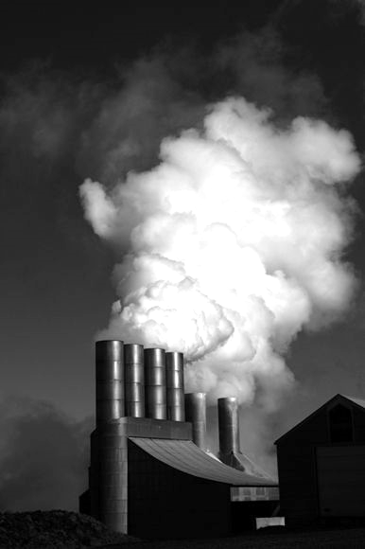


CUSP
London Data Dive 2025
a
Team 7
Yixing Li
Jianming Wu
Stella Yao
Sivasakthini M

Slide 2
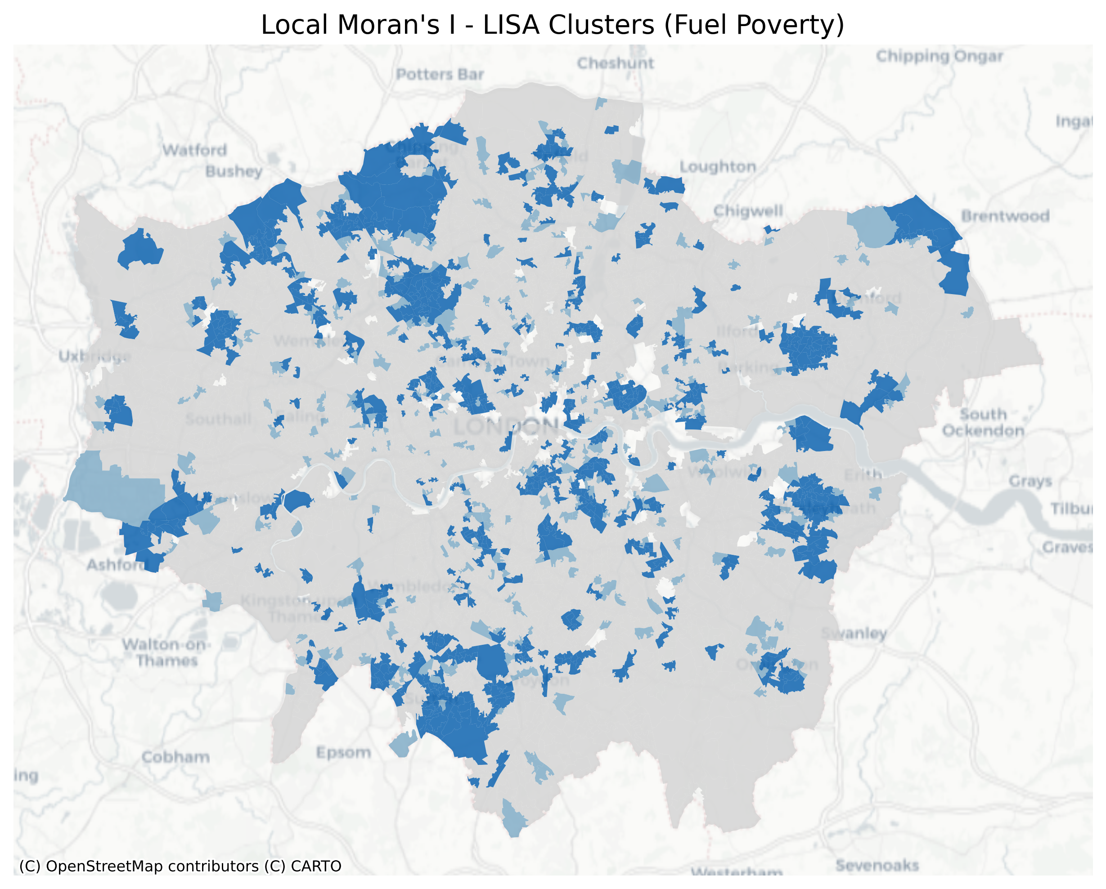

Background
Local Moran's I – Clusters of Fuel Poverty
Fuel Poverty:
Fuel poverty in England is measured using the Low Income Low Energy Efficiency (LILEE) indicator. Under this indicator, a household is considered to be fuel poor if: they are living in a property with a fuel poverty energy efficiency rating of band D or below and when they spend the required amount to heat their home, they are left with a residual income below the official poverty line. (“Fuel Poverty Statistics,” 2024)
Fuel poverty is a persistent issue in the UK which affects approximately 11% of households. (Simcock N, Walker G, Day R., 2016)
Research Questions
Are there disparities in energy efficiency ratings and socio-economic factors that could exacerbate fuel poverty in certain areas of London?​
How can existing policy gaps be addressed to mitigate regional inequalities in access to affordable heating energy and reduce fuel poverty?​
Moran’s I: 0.227, R-Value：0.001
The Moran’s I and Local Moran’s I values indicate a clustering pattern of energy poverty, with high-concentration areas (deep blue) primarily located in the northern, eastern, and southern parts of London.

Slide 3
Data Sources
Datasets | Study Themes | Key Variables | Scopes | Time
LSOA Atlas - London Datastore | Household income and housing characteristics | Median Annual household income | Greater London LSOA | 2011
 |  | Density of Households
 |  | Dwelling types
London Building Stock Model (LBSM) | Energy efficiency in buildings | Energy Efficiency Rating |  | 2017
Lower Super Output Area (LSOA), Middle Super Output Area (MSOA) and Intermediate Geography Zone (IGZ) electricity and gas estimates - data.gov.uk | Energy consumption patterns | Mean Electricity Consumption |  | 2011
 |  | Mean Gas Consumption
Property Build Period - London Datastore | Housing age and construction period | Average Built Year
Property Build Period - London Datastore | Housing age and construction period | Average Built Year |  | 2014
Fuel Poverty | Fuel poverty distribution | Percentage of Households in Fuel Poverty |  | 2011
Reference for factors choose:
The Home Upgrade Grant (HUG)
The Sustainable Warmth Competition
The Social Housing Decarbonisation Fund
The Energy Company Obligation (ECO)
The Great British Insulation Scheme
Simcock N, Walker G, Day R. Fuel poverty in the UK: Beyond heating[J]. People, Place and Policy, 2016, 10(1): 25-41.
Walker, R., McKenzie, P., Liddell, C., & Morris, C. (2014). Estimating fuel poverty at household level: An integrated approach. Energy and Buildings, 80, 469-479.
Independent Variables
Dependent Variable

Slide 4
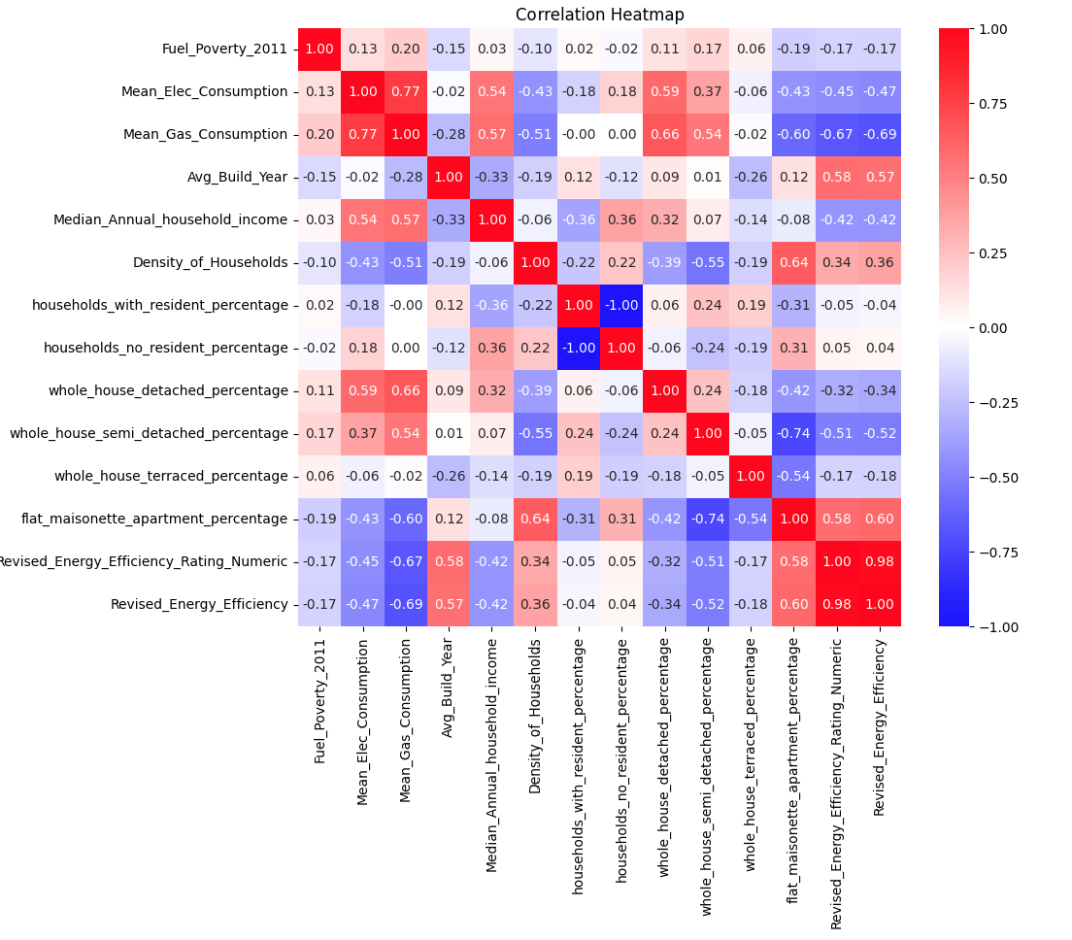
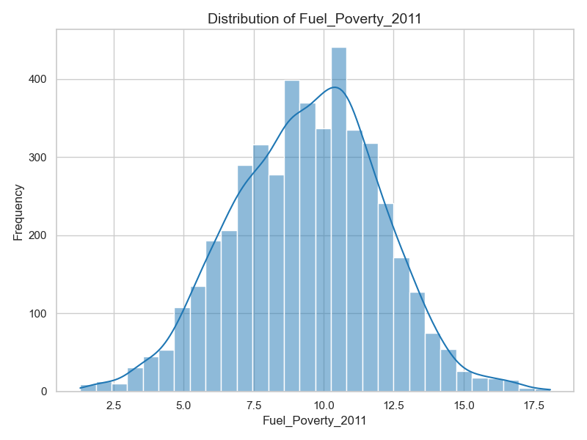
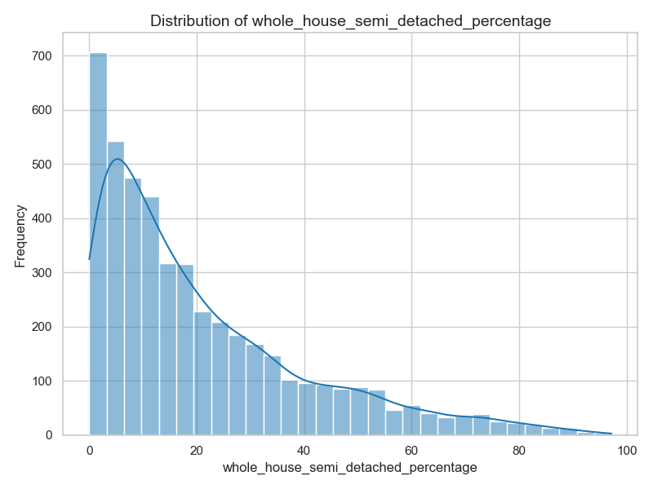
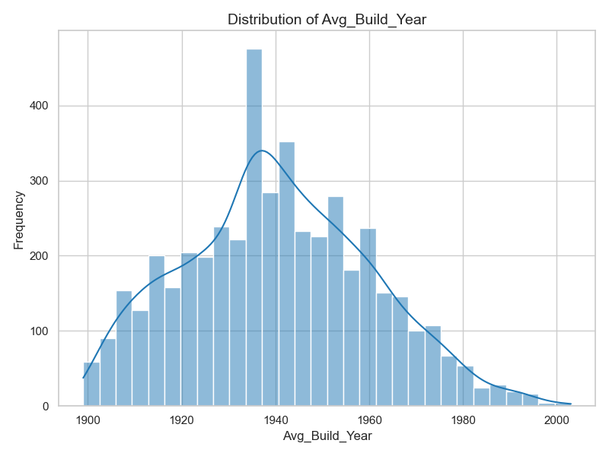
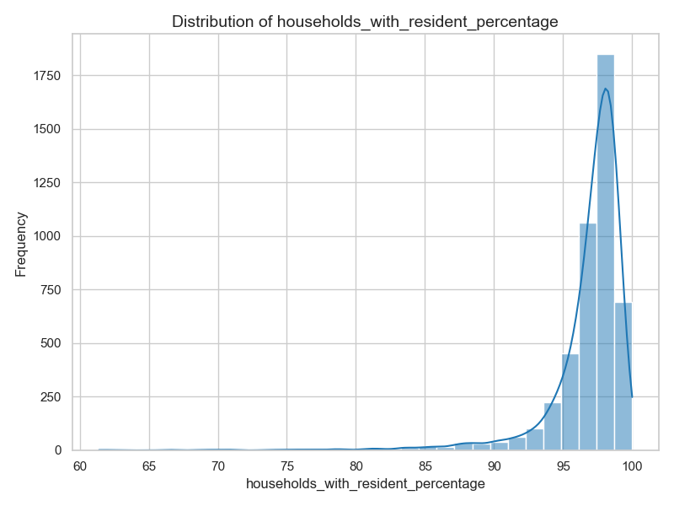
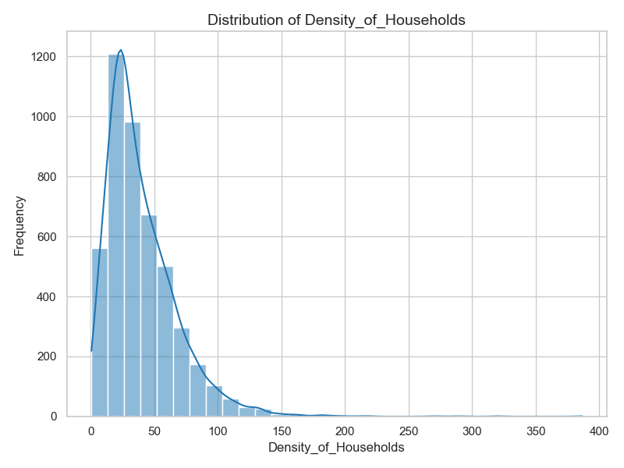
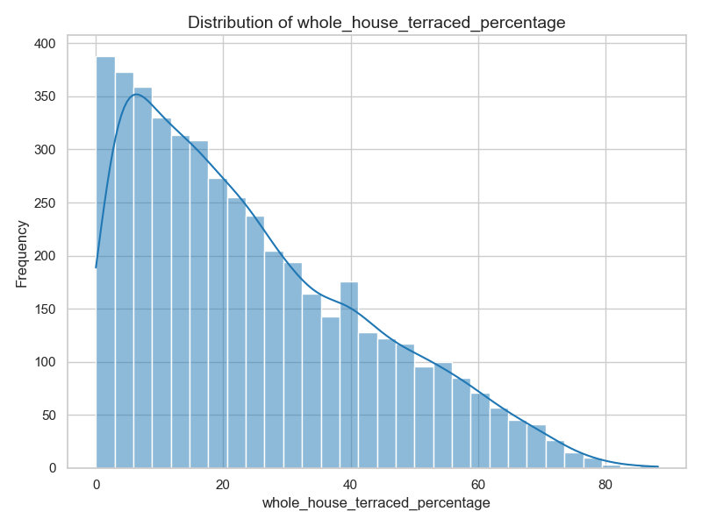
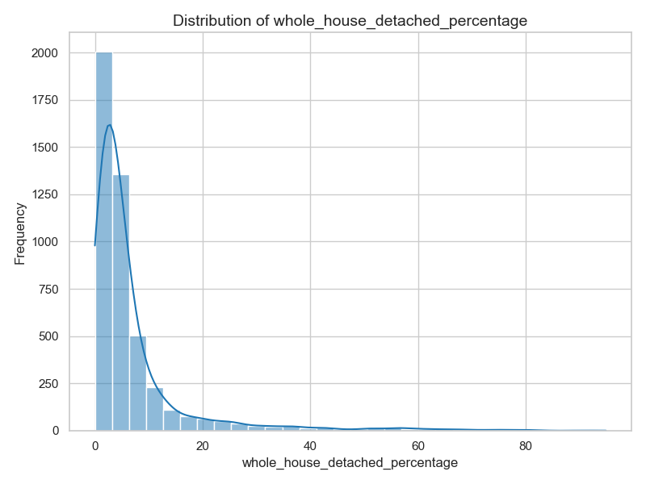
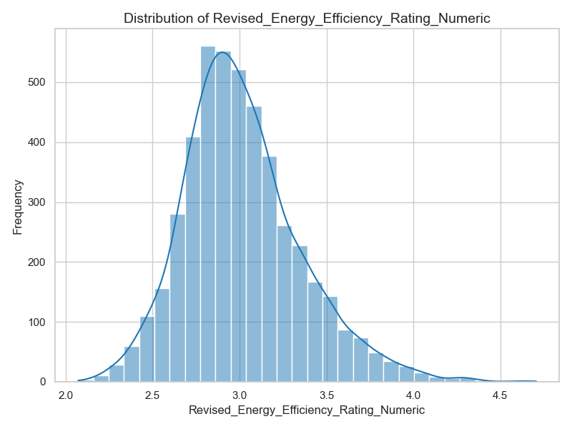
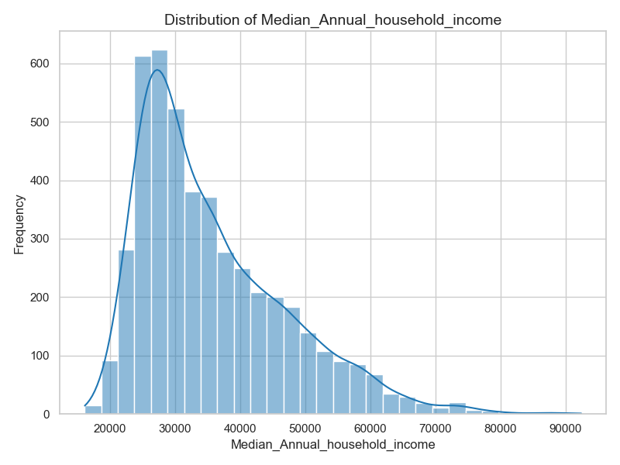
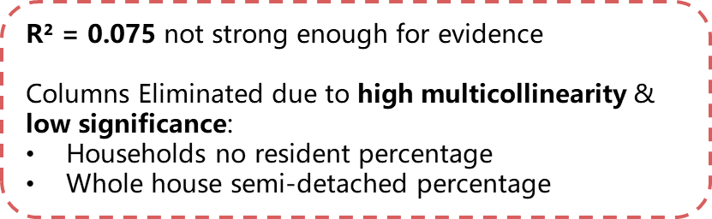
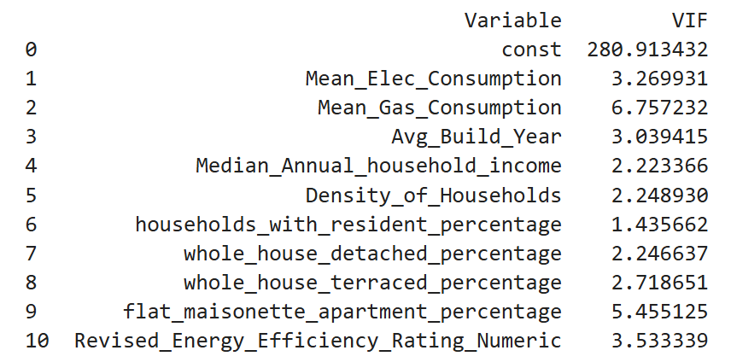
Variables Selection
The distribution of almost all factors exhibits skewness, reflecting the underlying inequality trends that exist within London.
Distribution Of Factors
Multiple Linear Regression​
VIF​ TEST

Slide 5
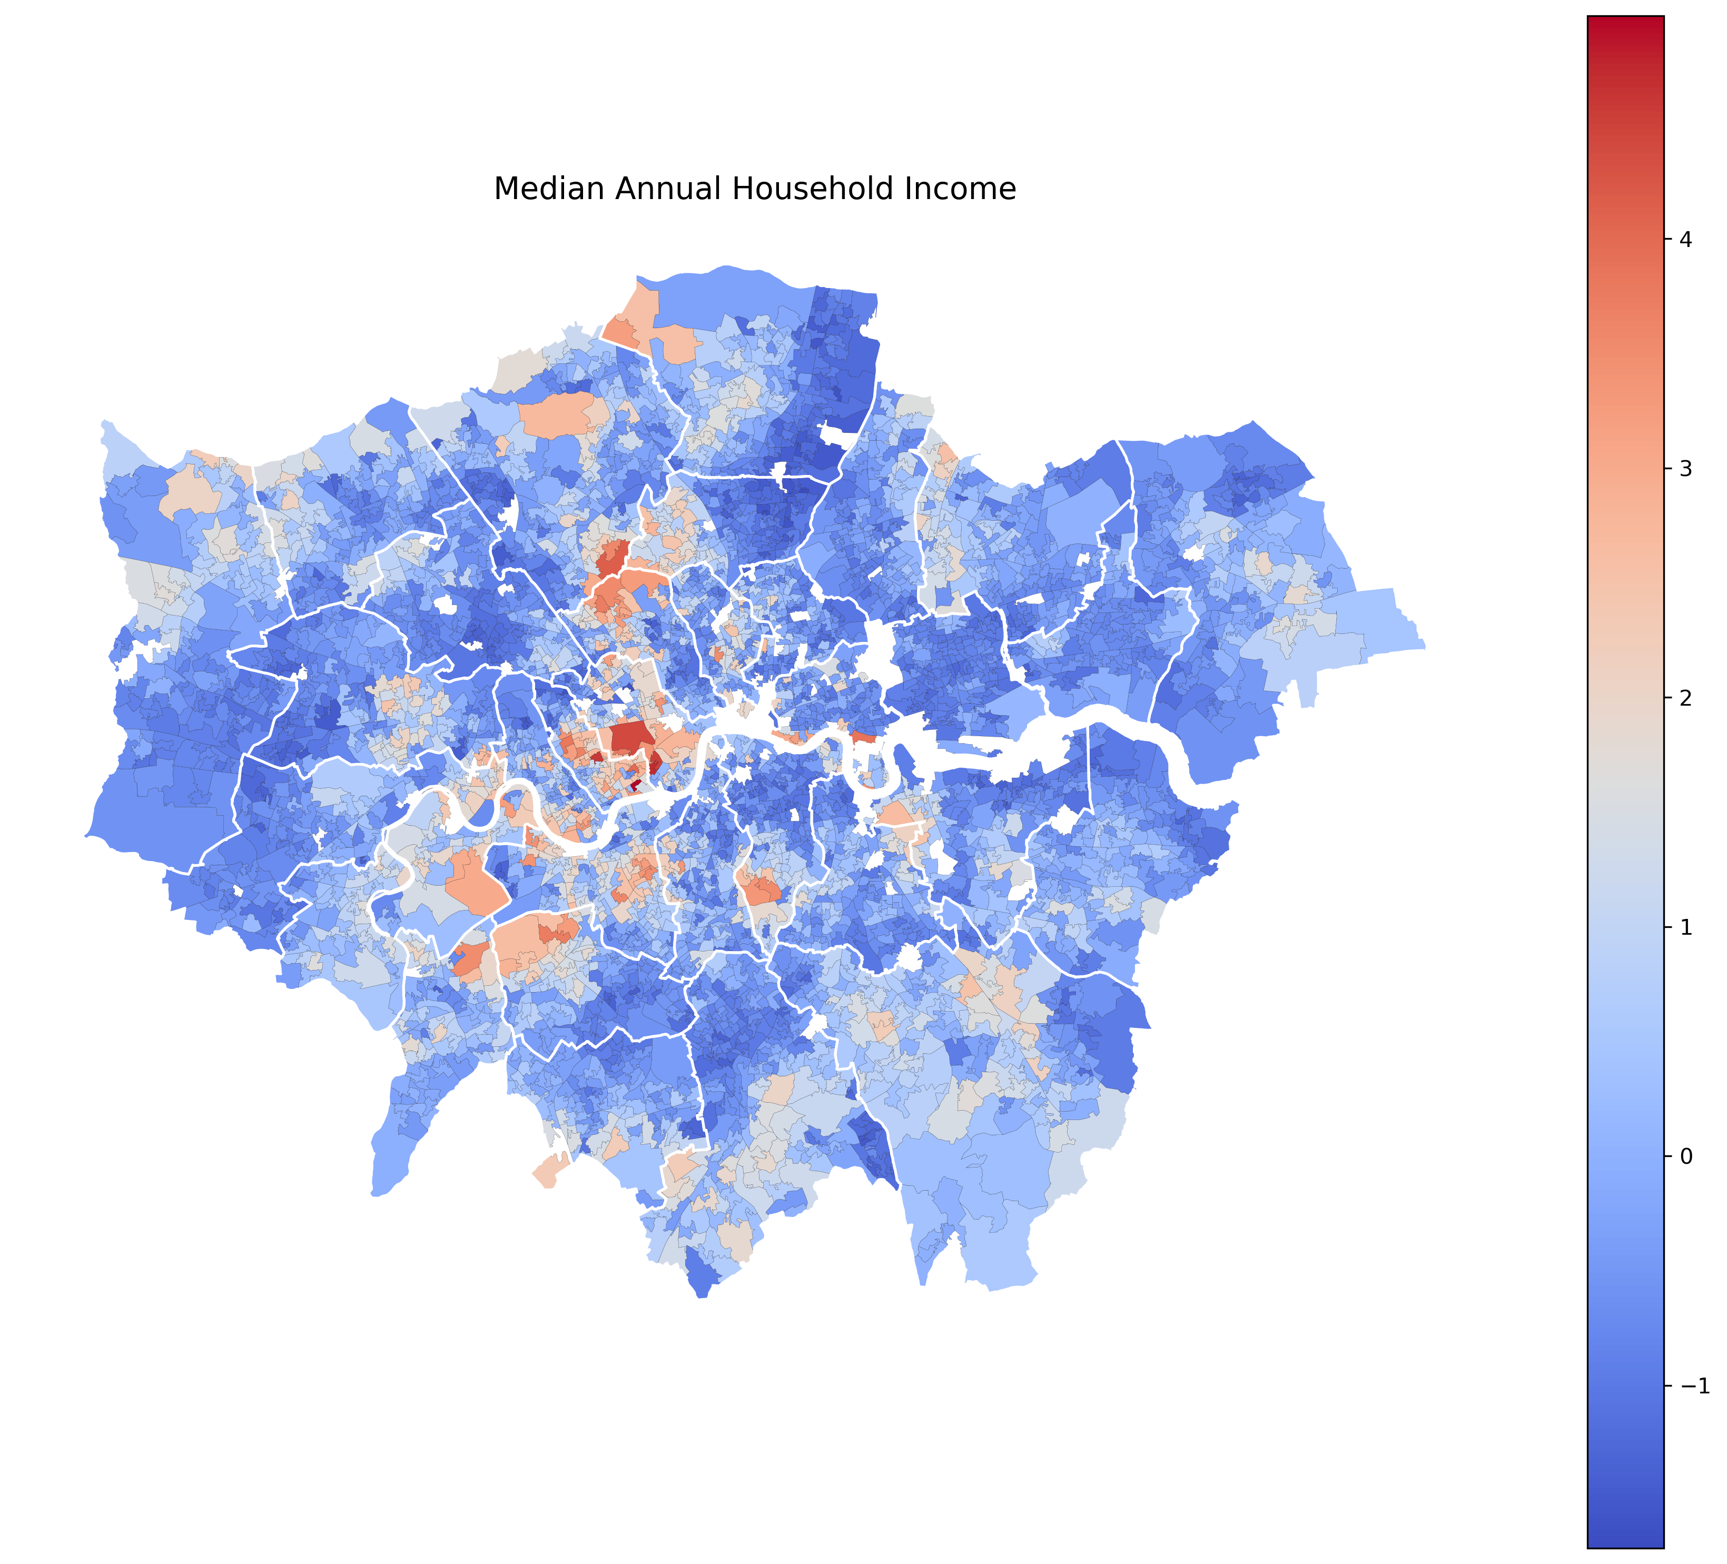
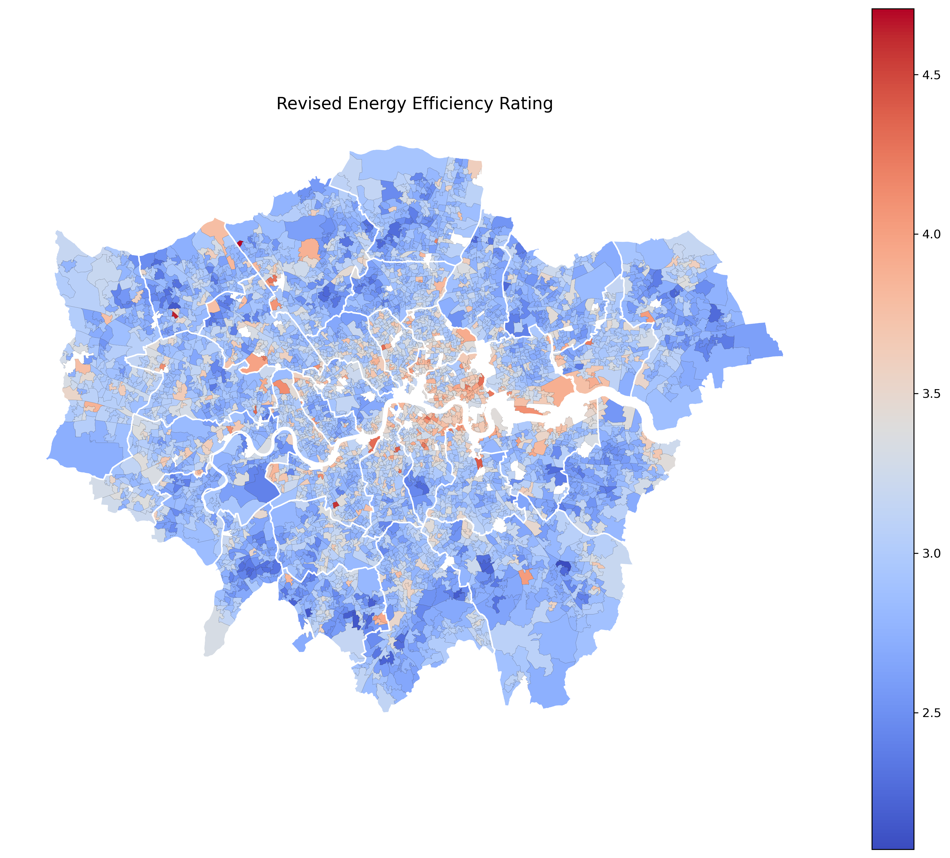
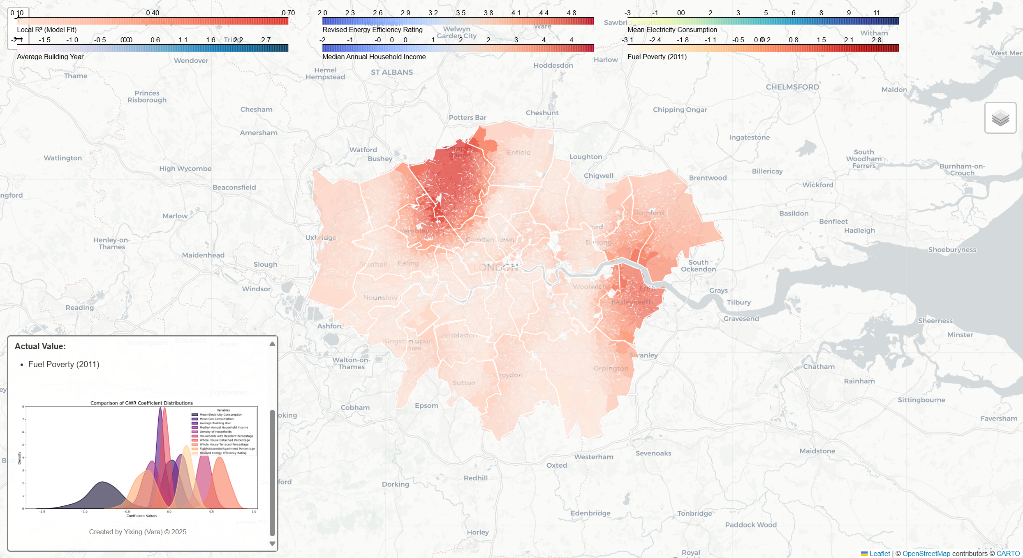
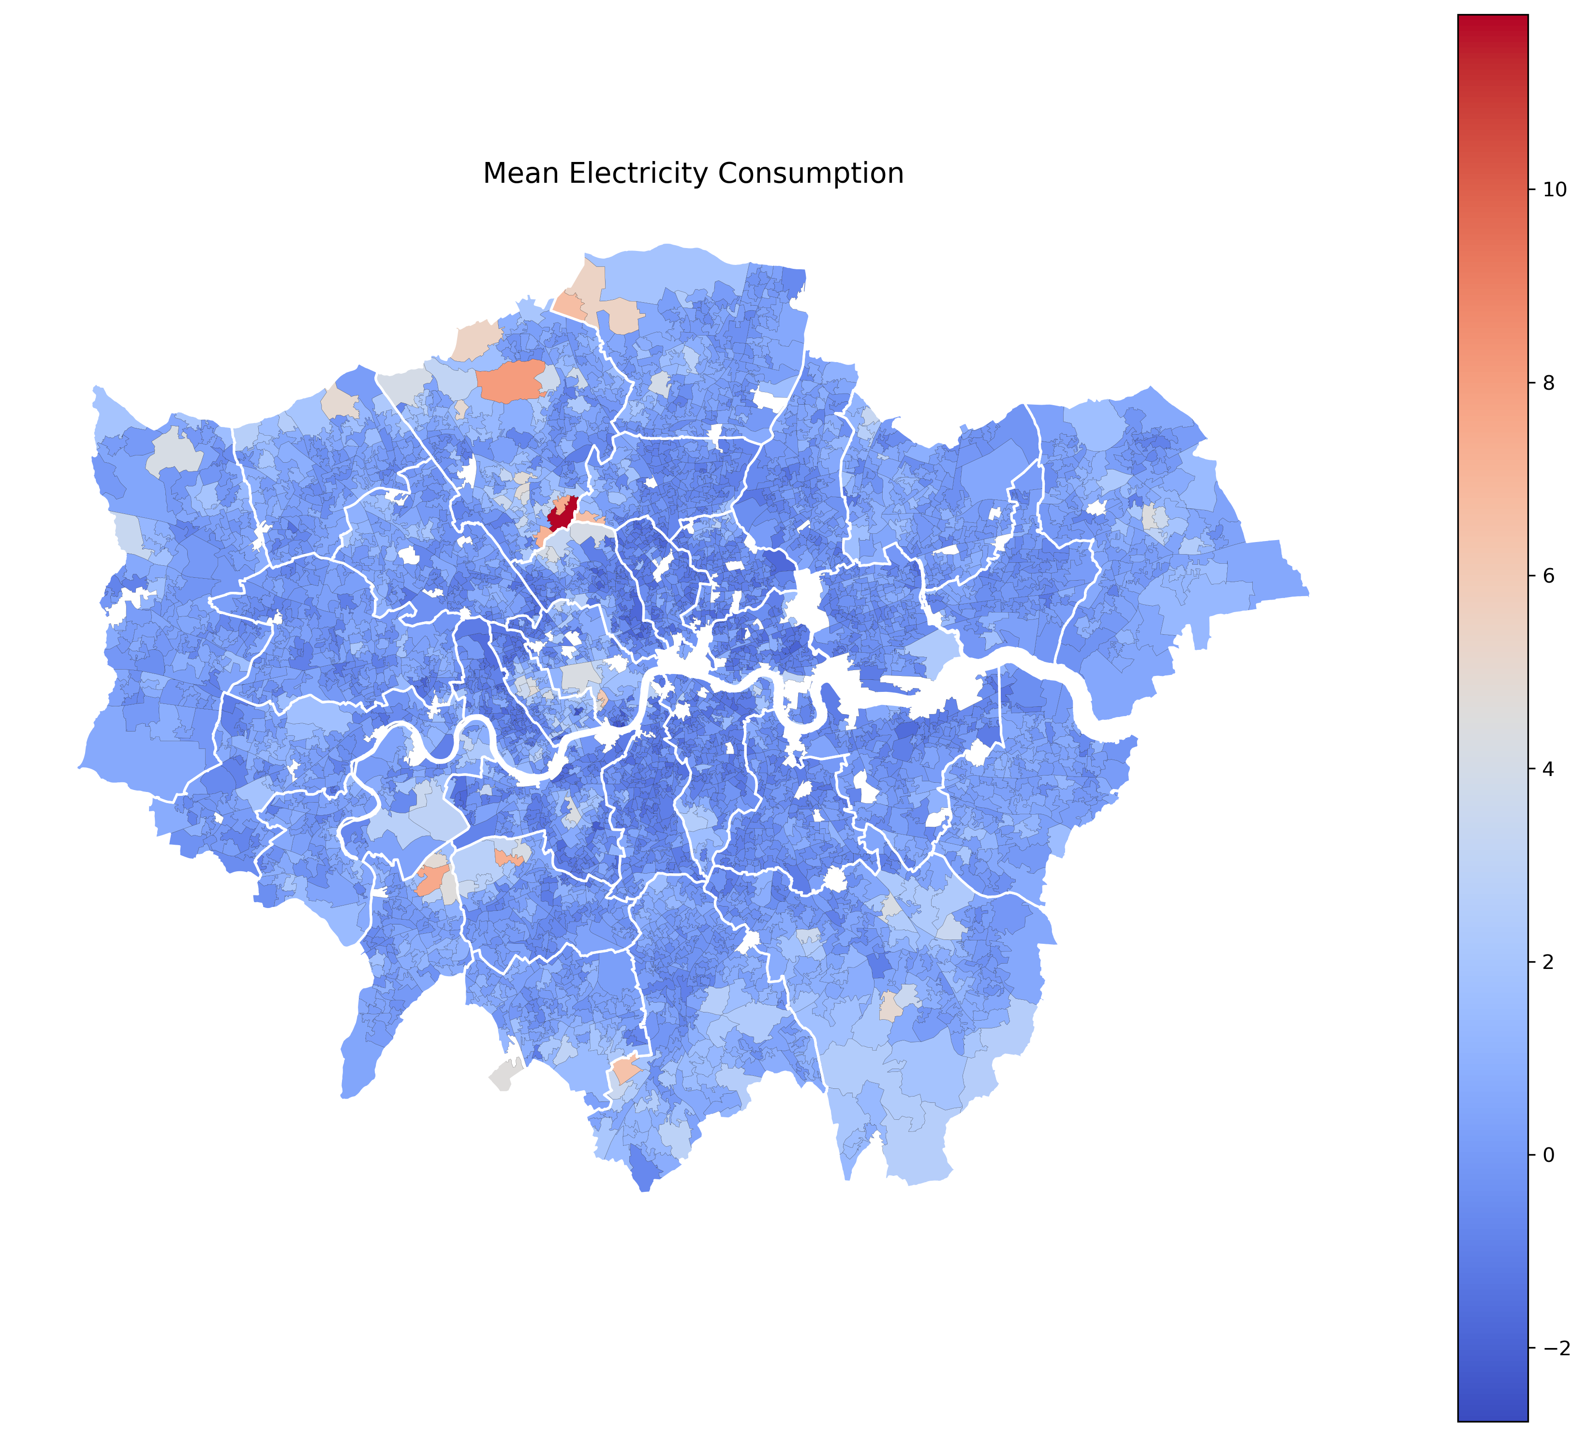
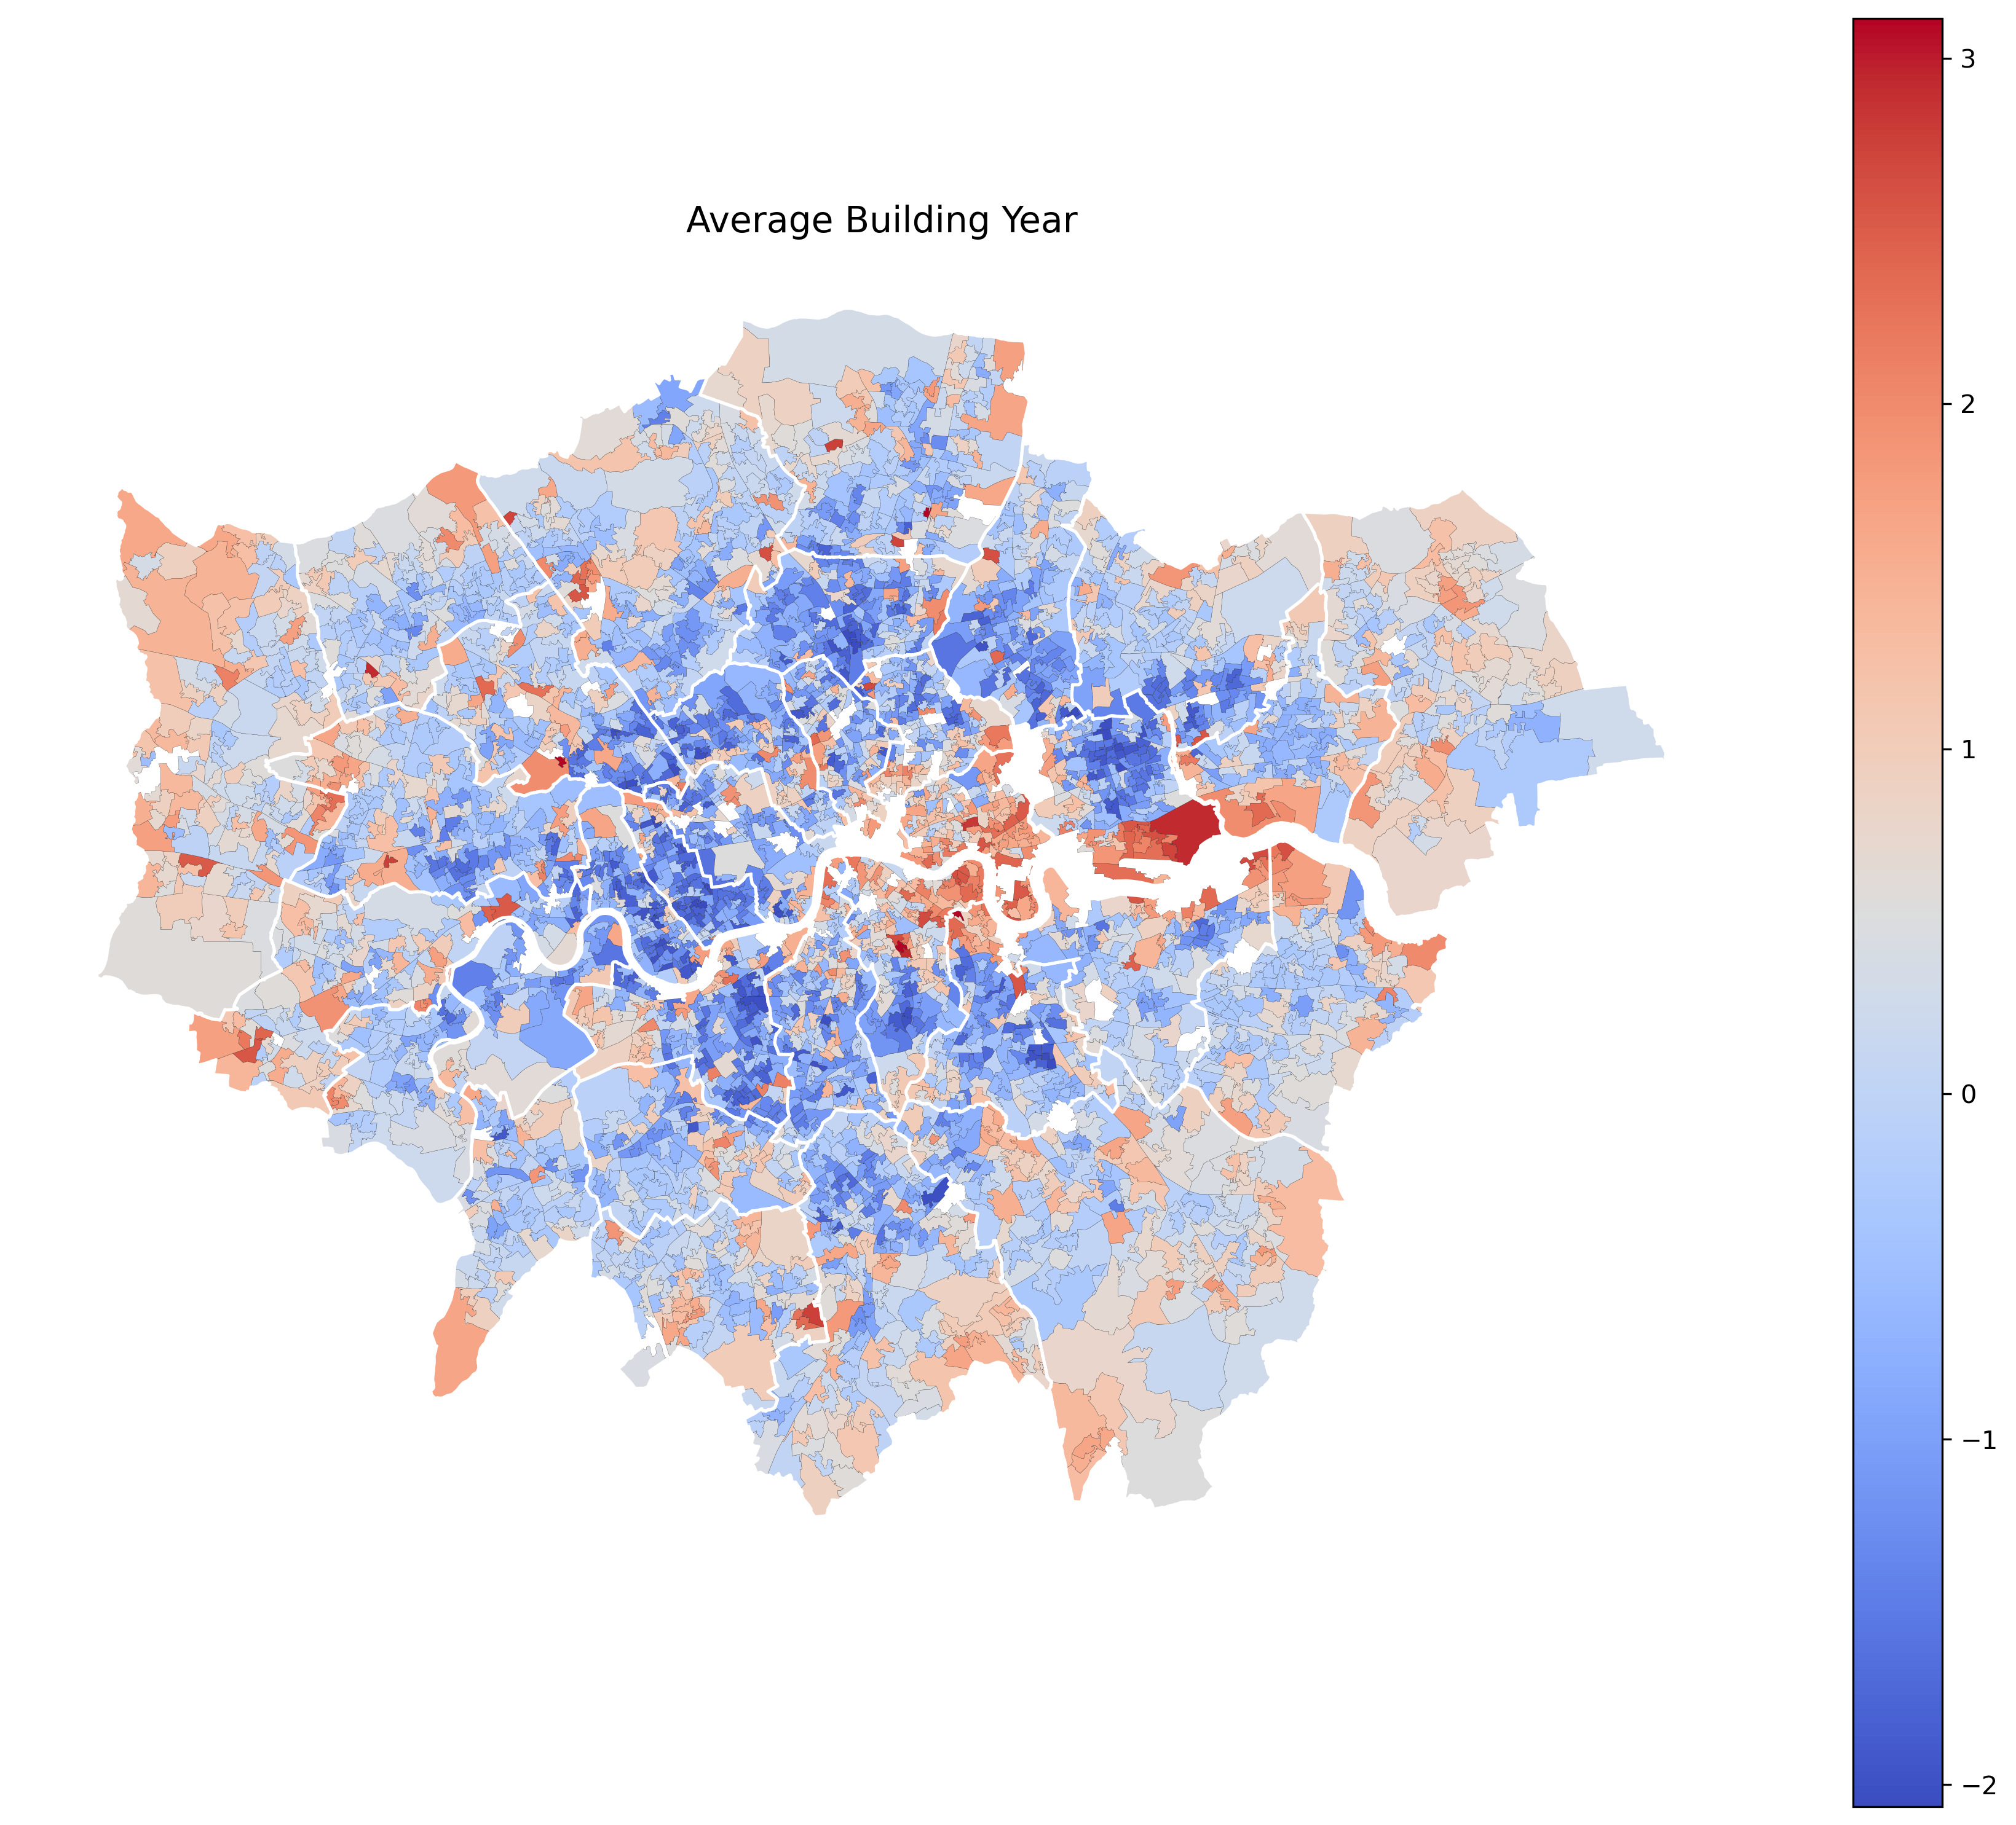
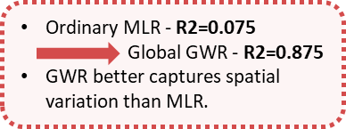
Spatial Variation - in Drivers of Fuel Poverty
Geographically Weighted Regression (GWR)
Annual Household Income (￡）
Revised Energie Efficiency Rating
Mean Electricity Consumption(￡）
Average Building Year
High R2 Zones:
Deep red areas - strong relationships / white – other factors are not considered
Significant Variables:
Median Annual Household Income: Higher income reduces fuel poverty
low-income areas (e.g., East London) linked to higher fuel poverty.
Average Building Year: Older buildings increase fuel poverty
Concentrated in city center and peripheral areas.
Mean Electricity Consumption: Higher consumption linked to fuel poverty.
In large-home, high-utility regions (redder zones).
Revised Energy Efficiency Rating: Better ratings reduce fuel poverty
Low efficiency in eastern/northern areas linked to higher fuel poverty.
Interactive map link for exploring: Spatial Insights into Fuel Poverty and Associated Factors in Urban Areas (GWR Results)

Slide 6
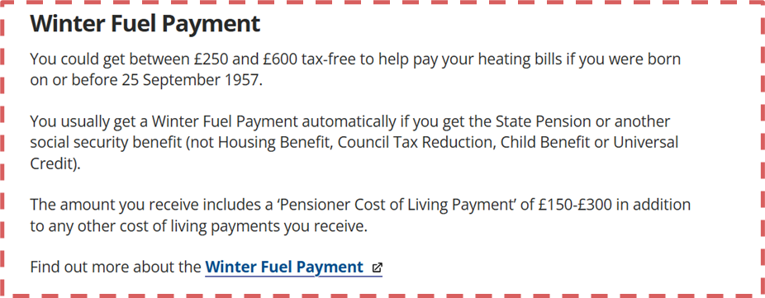
Policy Improvement & Insights
Policies should not adopt a one-size-fits-all approach but should instead be tailored to the specific characteristics of each area.
For example, North London may require building quality improvement programs, while South London would benefit more from enhanced financial support for low-income households.
FACTORS | POLICY | PATTERN | BOROUGHS
rv EPC | -energy retrofit programs | Eastern and Northern London | TowerHamlet/Newham/Lambeth/Hackney
Electricity Consumption | -income support measures -dynamic pricing mechanisms to reduce peak-hour costs | Haringey, Barnet | Haringey/Richmond/Upon Thames/Wandworth/Barnet
Built Year | -targeted renovation subsidies -public housing renewal initiatives | Eastern London | TowerHamlet/Newham/Camden/Croydon/Hillingdon
Income | -income support measures | Eastern London | Wesminster/Haringey/Wandsworth

Slide 7
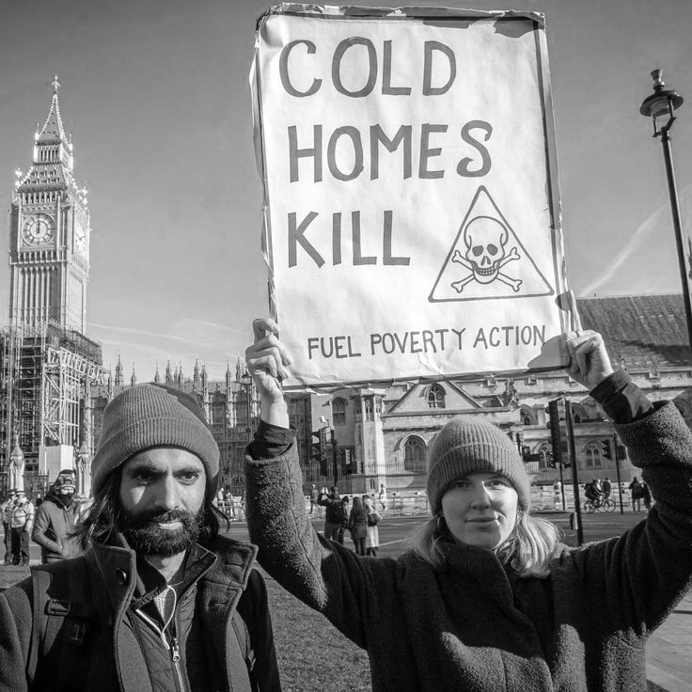
Limitations & Future Development
Biases from data sources:
Lack of differentiation in electricity and gas data for heating purposes
Limited coverage of energy sources
Variable Definition Limitations:
- Lack of quantitative data on building energy transmission infrastructure
Temporal Limitations:
Data covers only a specific time period (2011-2017), limiting the generalizability of trend analysis (EPC & Fuel Poverty Data Lag)
Model Fit Limitations:
- Spatial scale accuracy issues
- Inconsistent GWR accuracy across regions

Slide 8
Thanks for your Listening!
References
Li, X., Hou, S., Patterson, J., Perisoglou, E., Ionas, M., Jenkins, H., Jones, P., Lannon, S., & Coma Bassas, E. (2019). Modelling and developing a neighbourhood low carbon system for five dwellings in the UK.
Simcock, N., Walker, G., & Day, R. (2016). Fuel poverty in the UK: Beyond heating. People, Place and Policy, 10(1), 25-41.
Walker, R., McKenzie, P., Liddell, C., & Morris, C. (2014). Estimating fuel poverty at household level: An integrated approach. Energy and Buildings, 80, 469-479.
Poortinga, W. (2019). Health and social outcomes of housing policies to alleviate fuel poverty. In Urban Fuel Poverty (pp. 239-258). Academic Press.
Fuel poverty statistics. (2024, February 15). Retrieved from GOV.UK website: https://www.gov.uk/government/collections/fuel-poverty-statistics#2023-statistics
Funding for community projects. Retrieved from Newham London website：https://www.gov.uk/government/collections/find-energy-grants-for-you-home-help-to-heat

